Slide 1


Plant2Go
PERSONAS
Lydia Reiter, Yaminia Pagoada, Julia Kiss, Lena Wurmsdobler & Wenxi Yang
Präsentation 4
12.12.2024

Slide 2
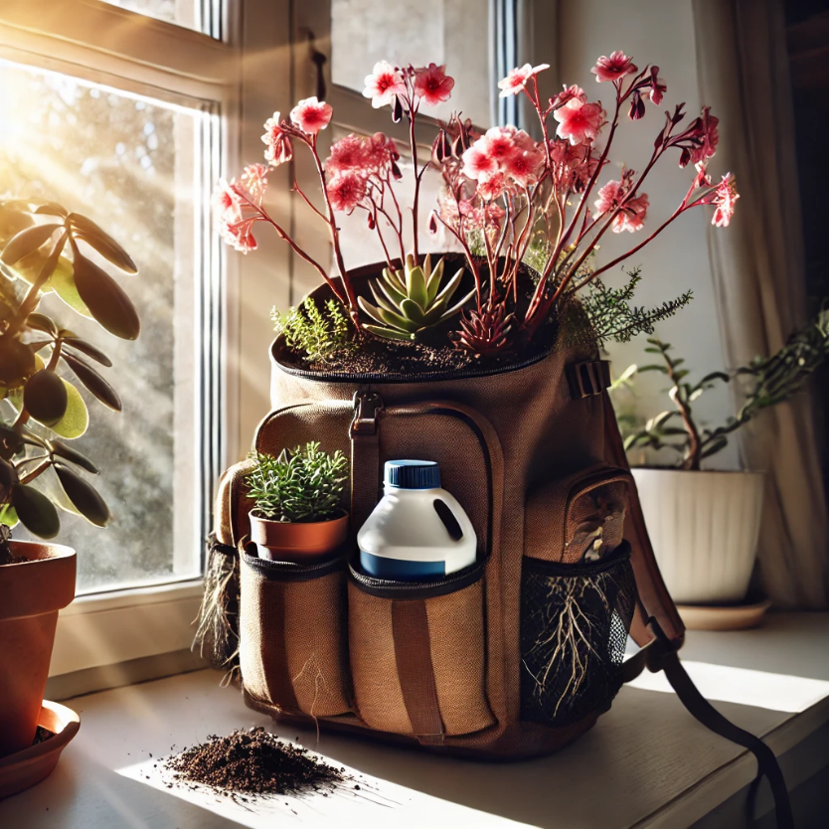
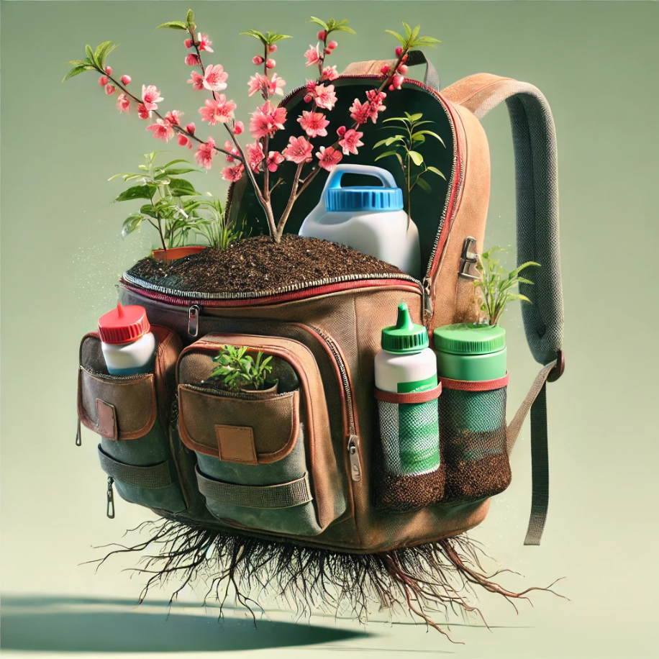
Inhalt
Personas
How Might We
Moodboard
Actant Mapping
Interview 1

Slide 3

Personas

Slide 4
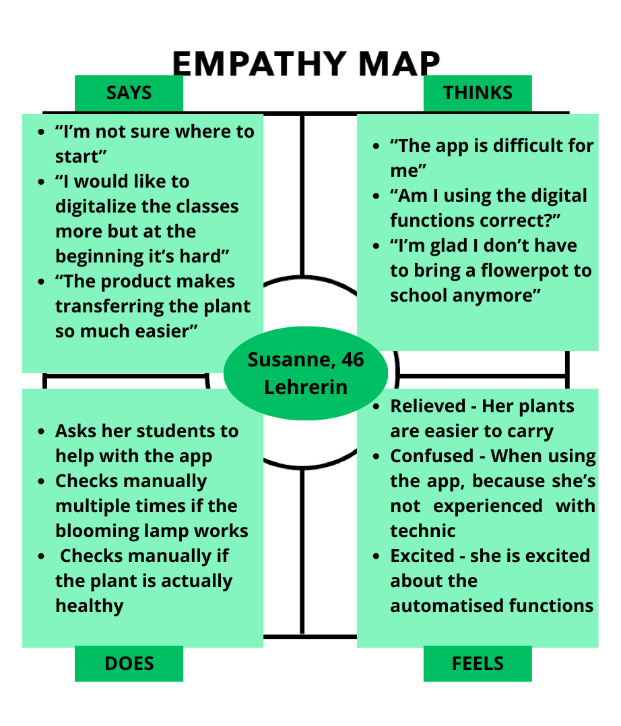


Humane
Persona

Slide 5
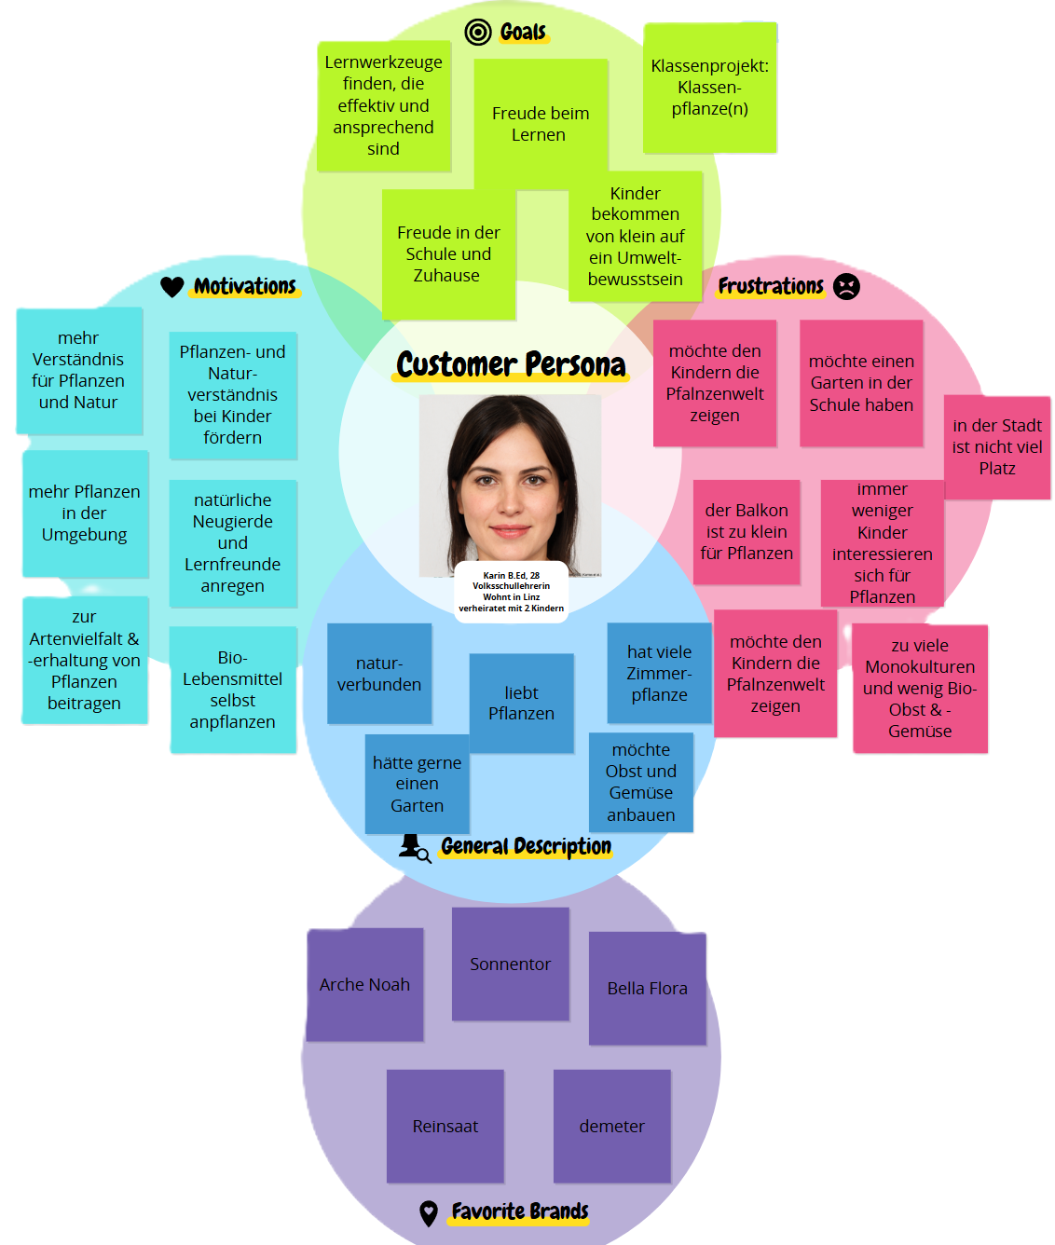
Humane
Persona

Slide 6
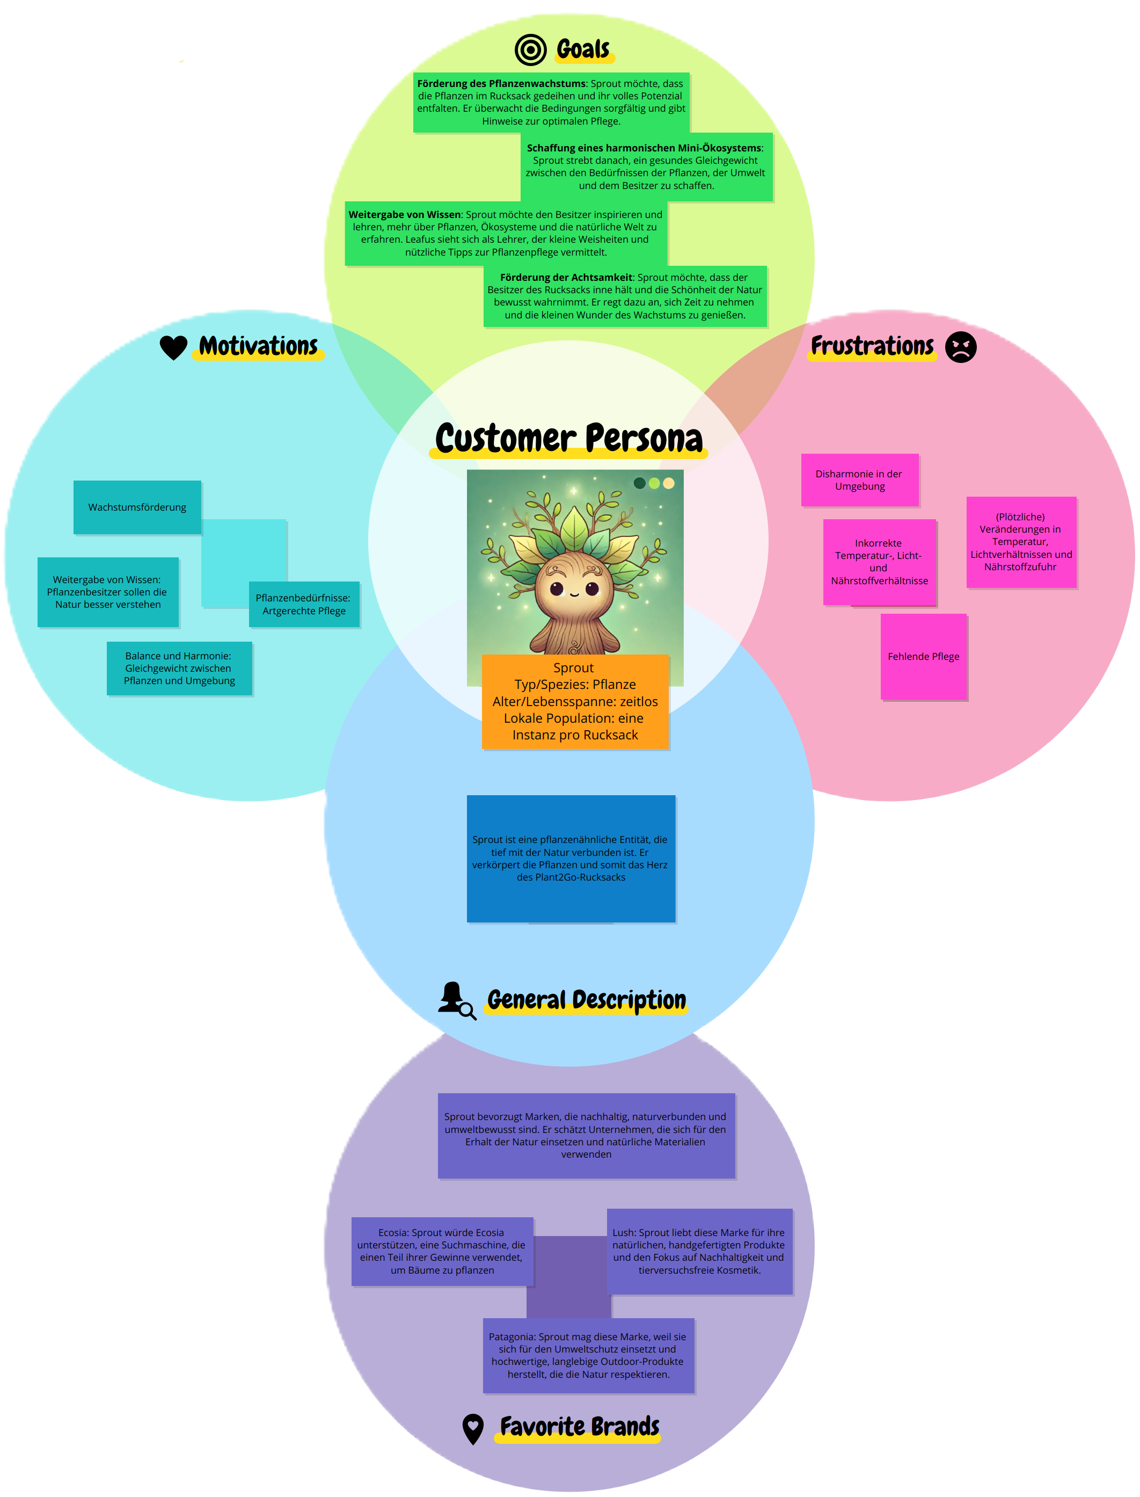
Non-humane
Persona

Slide 7
How Might We

Slide 8
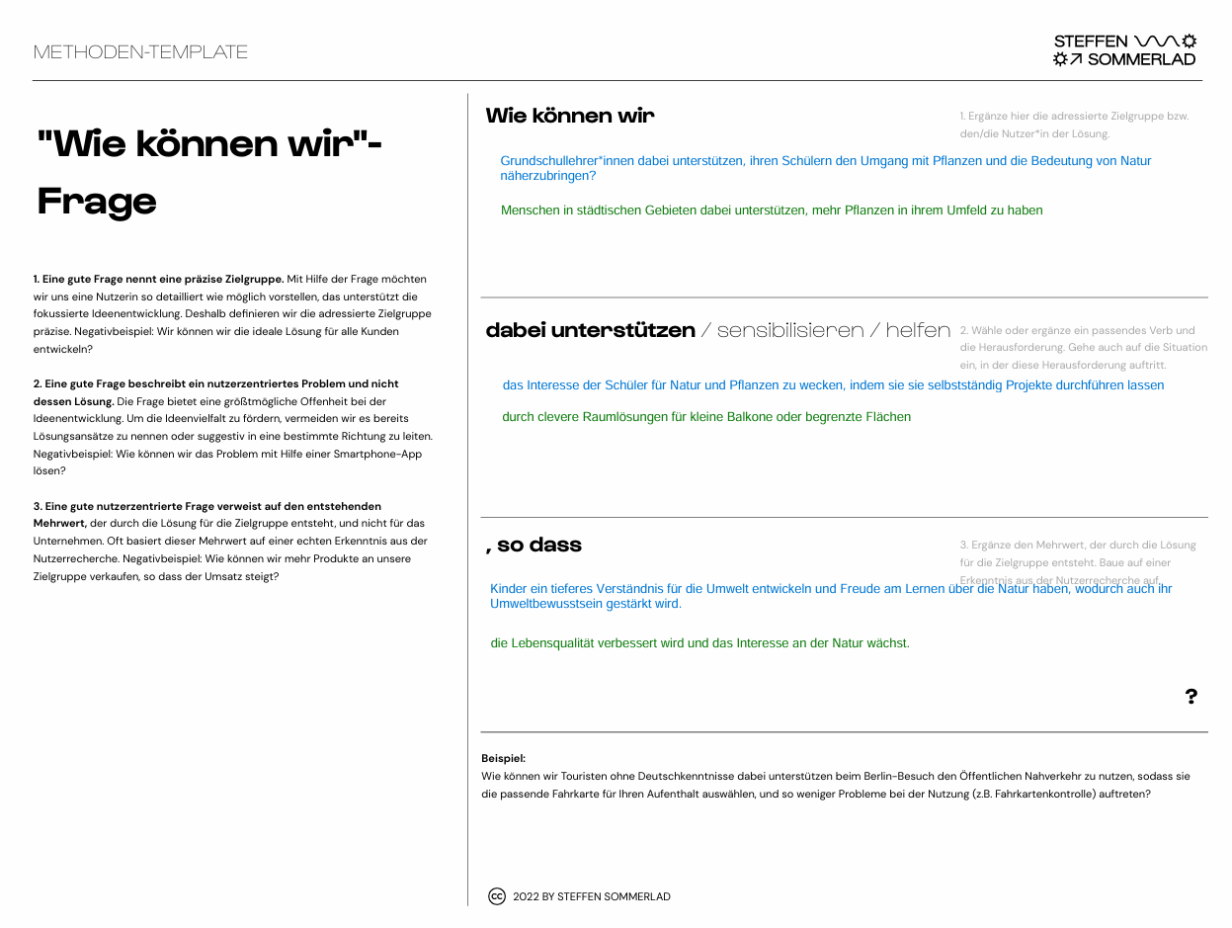

Slide 9
Moodboard

Slide 10


Slide 11
Actant Mapping

Slide 12
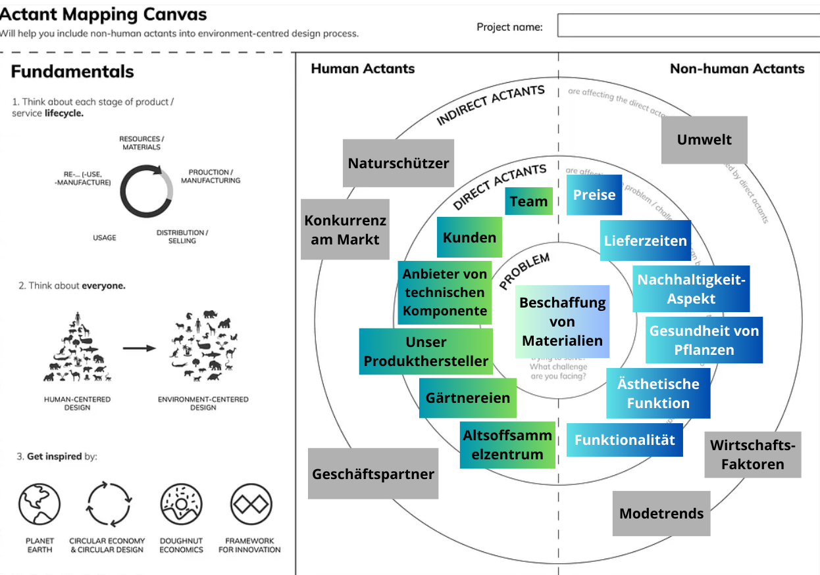

Slide 13
Interview 1

Slide 14
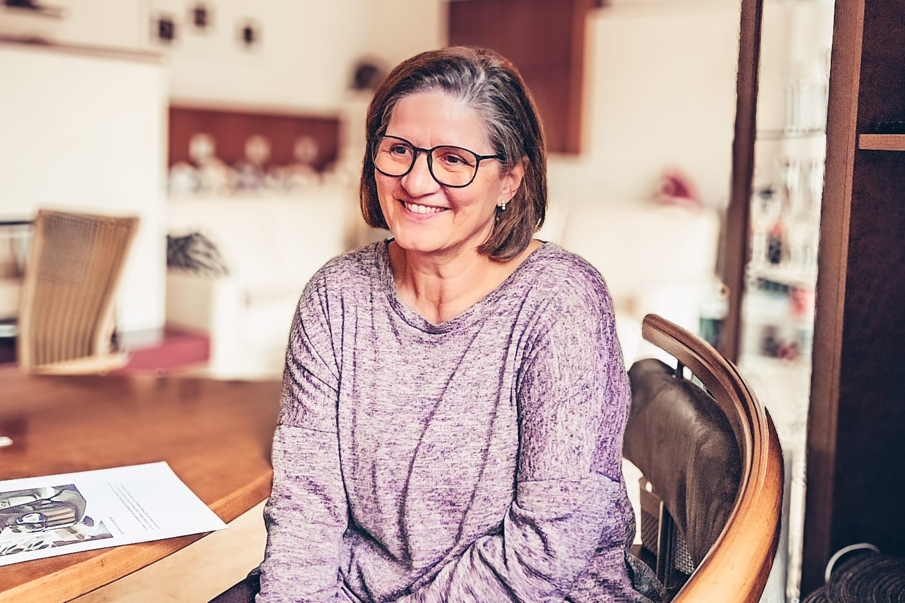
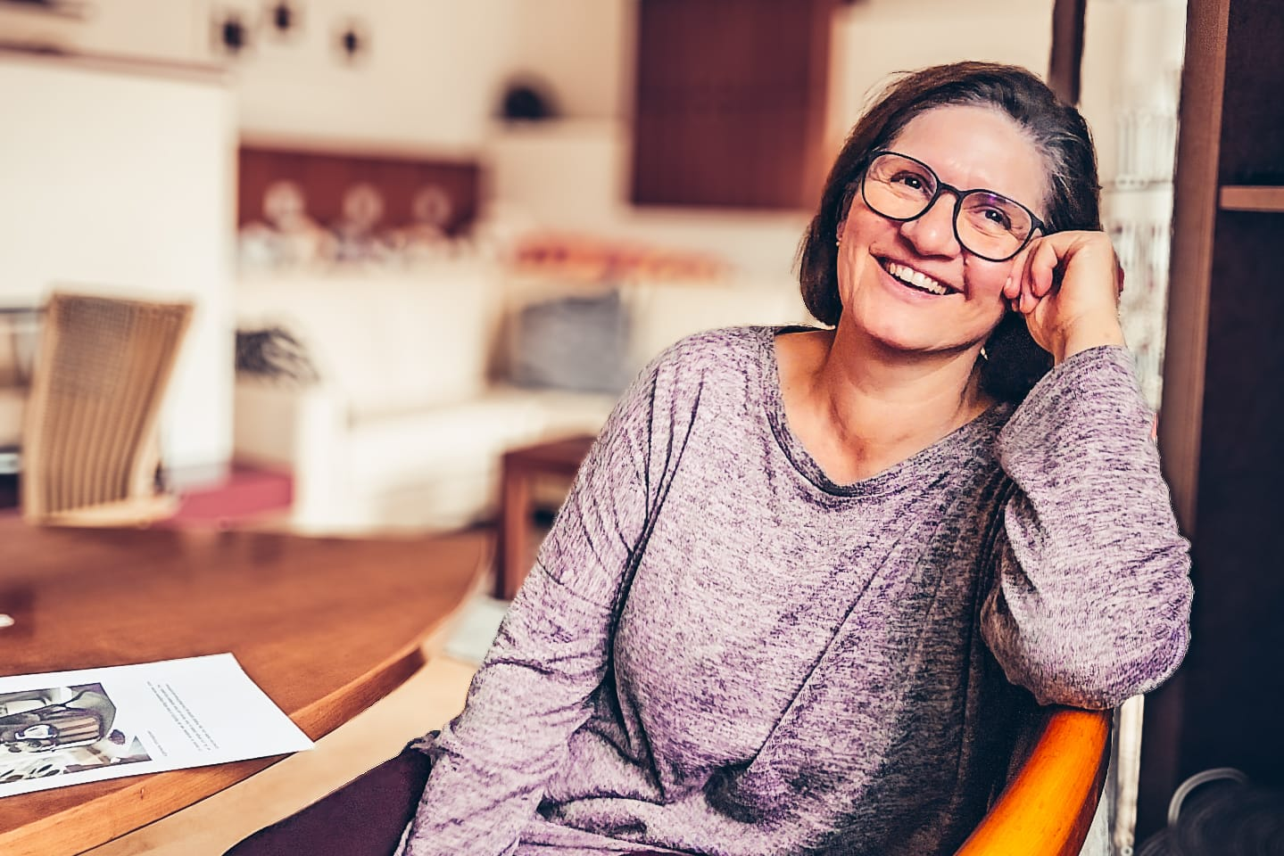
Interview: Gerlinde Kreuzhuber
40 min/Video

Slide 15


